Slide 1
The Role of Radiation in the Management of Gynecologic Cancers Scott Glaser, MD

Slide 2
DISCLOSURE
Nothing to disclose

Slide 3
Outline
The role of radiation in:
Endometrial Cancer
Adjuvant
Medically inoperable
Cervical Cancer
Post-operative for early stage
Definitive for locally advanced
Vaginal Cancer
Vulvar Cancer
Ovarian Cancer

Slide 4
Endometrial Cancer
Most common presenting symptom is post-menopausal bleeding
Ultrasound performed and demonstrates thickened endometrial stripe (>4mm)
Endometrial biopsy performed
If positive, complete work-up and proceed to surgery

Slide 5
Endometrial Cancer
Surgically managed disease
Total hysterectomy with regional lymph node evaluation is the first step in management
Growing role of SLNBx
Staging largely dependent upon surgical findings
Risk of recurrence is dependent upon stage and histology
Guides adjuvant therapy recommendations
Notes:
FIRES Trial

Slide 6
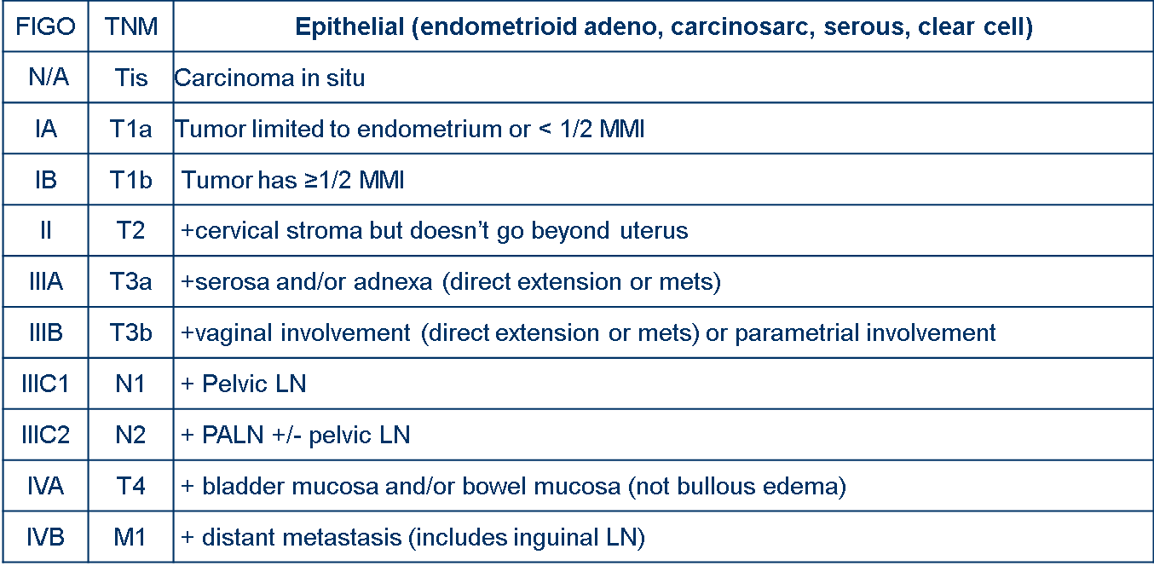
Endometrial Cancer

Slide 7
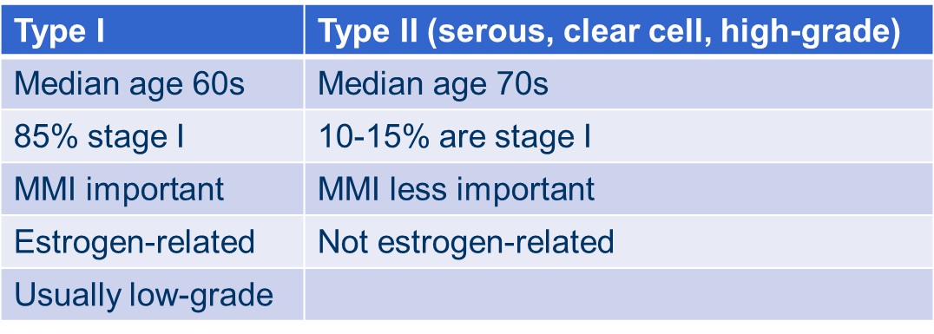
Endometrial Cancer
Epithelial
Type 1 (AKA Endometrioid adenocarcinoma):
Most common histology is endometrioid adenocarcinoma
~80% of endometrial cancer
Type 2 (serous, clear cell, carcinosarcoma [MMMT])
Notes:
Mesenchyml = sarcomas

Slide 8
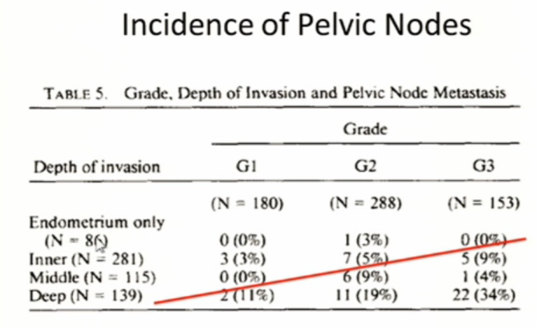
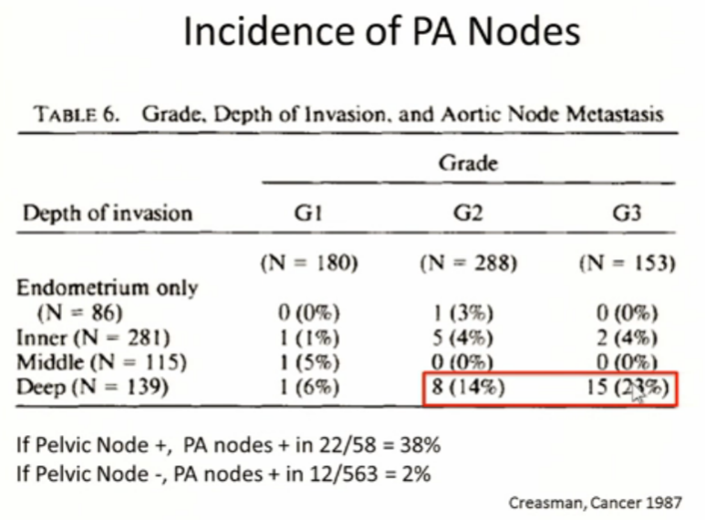
Endometrial Cancer
<5%
>10-40%
>15% if deep invasion + Gr2-3
Notes:
GOG 33

Slide 9
Endometrial Cancer – Stage 1
What are the most common sites of recurrence:
Vaginal cuff 10% (~75% of LRR)
Pelvic lymph nodes 4%
Distant 7%

Slide 10
Endometrial Cancer – Stage 1
How can we reduce this risk?
Portec 1
GOG 99
Portec 2

Slide 11
Endometrial Cancer – Stage 1
What predicts for locoregional recurrence?
GOG 99 (had LN dissection)
Outer 1/3 myometrial invasion
Grade 2 or 3
LVSI
Portec 1 (No LN dissection)
Outer 1/2 myometrial invasion
Grade 3
Age >60
Patients classified as “High-Intermediate Risk” if:
GOG: Age>70 + 1 RF, Age 50-70 + 2 RF, Age<50 and 3 RF
Portec: 2/3 Risk Factors
20-25% risk of LRR in HIR group

Slide 12
Endometrial Cancer – Stage 1
PORTEC 1 & GOG 99
Post Op pelvic EBRT vs Obs
Intermediate Risk
decreased LRR from 12-14% to 3-4%
High-Intermediate Risk
Decreased LRR from 18-26% to 5-6%
Low-Intermediate Risk
Decreased LRR from 5-6% to 2%
Site of locoregional relapse
~75% vaginal

Slide 13
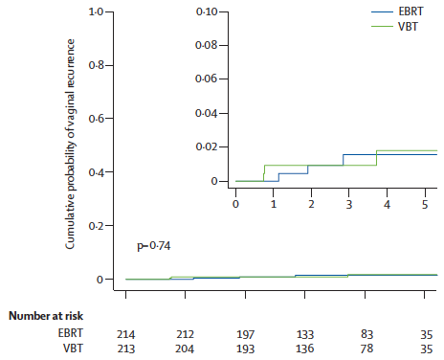
Endometrial Cancer – Stage 1
Portec 2
Phase III Randomized Trial
EBRT vs VBT
Population
H-I Risk Patients
Primary endpoint
vaginal relapse
Non-inferiority

Slide 14
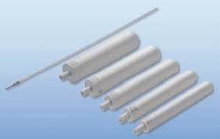
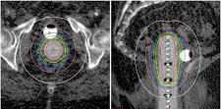
Endometrial Cancer
What is vaginal brachytherapy?

Slide 15
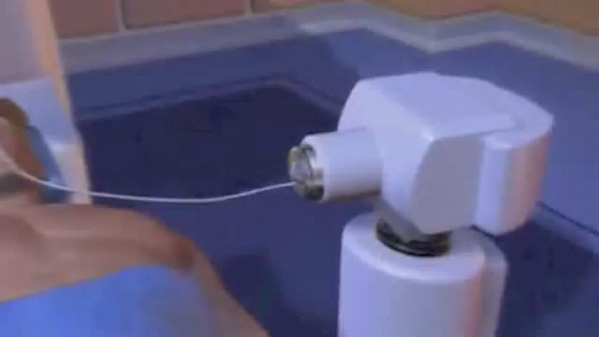
Endometrial Cancer

Slide 16
Endometrial Cancer
Vaginal Brachytherapy
Acute Toxicity
Gastrointestinal - 12% grade 1 or 2
Late Toxicity
Gastrointestinal - <1% grade 3
Vaginal atrophy – 2% grade 3
Most studies describe late toxicity rate of 1-5%
Do all patients need radiation?
Sorbe et al, (Int J Gynecol Cancer, 2009)
N=645, IA G1-2, Randomized VBT or Obs
Vaginal recurrence rate of 3.1% vs. 1.2% (NS)

Slide 17
Endometrial Cancer

Slide 18
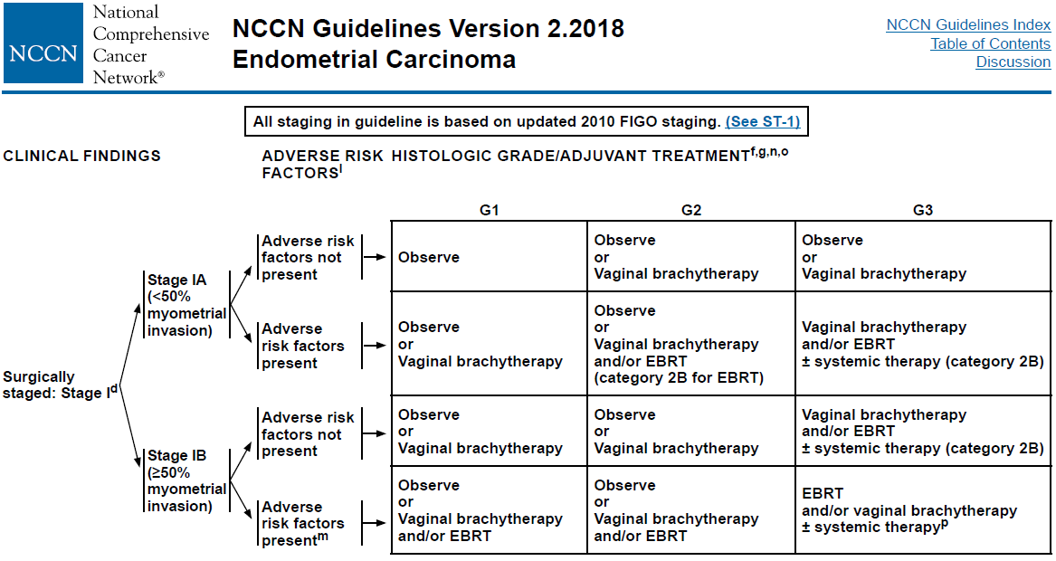
Endometrial Cancer

Slide 19
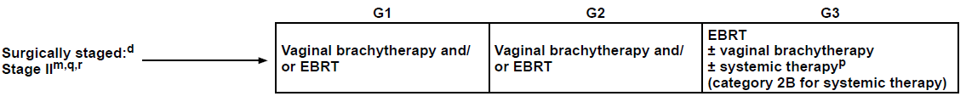
Endometrial Cancer – Stage 2
Stage II
Stage II
Rare presentation
Data limited primary to retrospective reviews
Brachy or EBRT both reasonable depending on grade and extent of disease

Slide 20
Endometrial Cancer – Stage 2
Harkenrider et al. (Int J Radiat Oncol Biol Phys, 2018)
Multi-institutional analysis (7 institutions)
Endometrioid Type Stage II treated with Adjuvant Vaginal Brachytherapy alone (N=92)
Median follow up 39.0 months
Surgery
98% had total hysterectomy, 2% radical hysterectomy
88% had pelvic lymph nodes removed
90% G1-2
98% had microscopic cervical involvement
5 year vaginal and pelvic failure rate 2.6% and 4.2%, respectively
5 year risk of distant failure was 7.2%

Slide 21
Endometrial Cancer – Stage 3
Stage IIIA-B
Similar to stage II, relatively rare with individualized therapy
Stage IIIC (LN+)
Historically managed with combination of radiation (EBRT +/- brachytherapy) and/or chemotherapy
GOG 122: Chemo alone better than EBRT alone
Recent trials have sought to better define the role of both chemotherapy and radiotherapy
Portec 3: RT+/- Chemo
GOG 258: Chemo +/- RT

Slide 22
Endometrial Cancer – Stage 3
Portec 3
660 patients with FIGO II-III endometrial or I-III Serous/Clear
Randomized to RT or Chemo-RT (concurrent Cis, Adj Carbo/taxol x4)

Slide 23
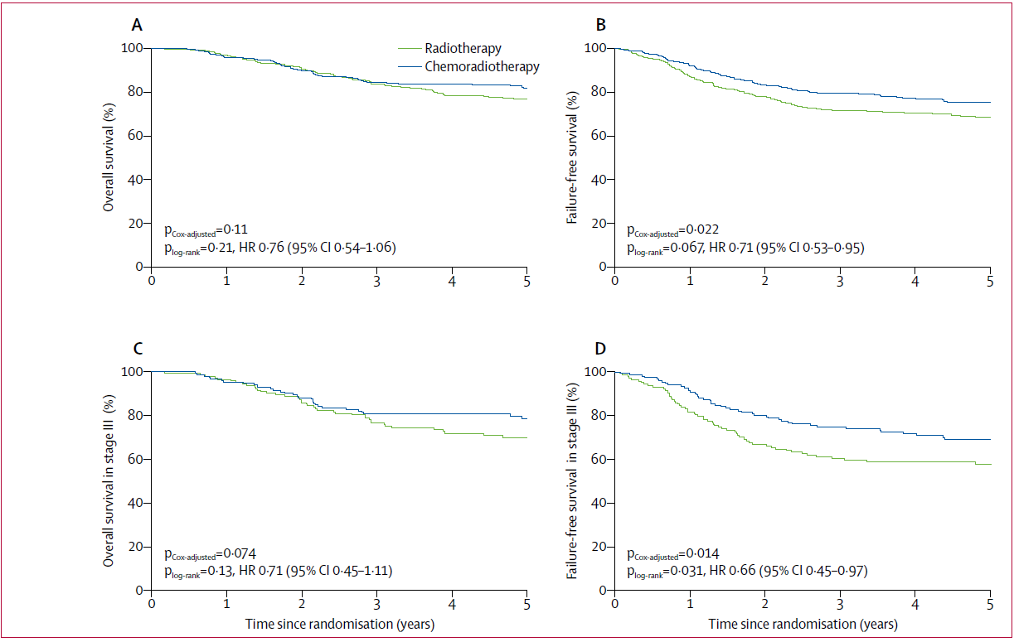
Endometrial Cancer
All Pts
Stage
III

Slide 24
Endometrial Cancer – Stage 3
GOG 258 (ASCO 2017)
733 pts, stage III-IVa endometrioid, stage I-II serous/clear
Randomized to Chemo (Carbo/Taxol x6) or Chemo-RT (concurrent Cis, Adj Carbo/taxol x4)
5-yr outcomes
Vaginal Recurrence 7% vs 3%
Pelvic/PA Recurrence 19% vs 10%
Distant Recurrence 21% vs 27%
Awaiting Final Publication

Slide 25
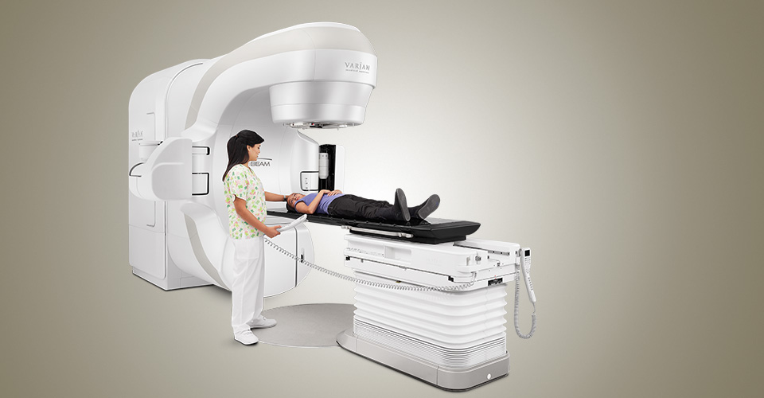
Endometrial Cancer
How is EBRT delivered?

Slide 26
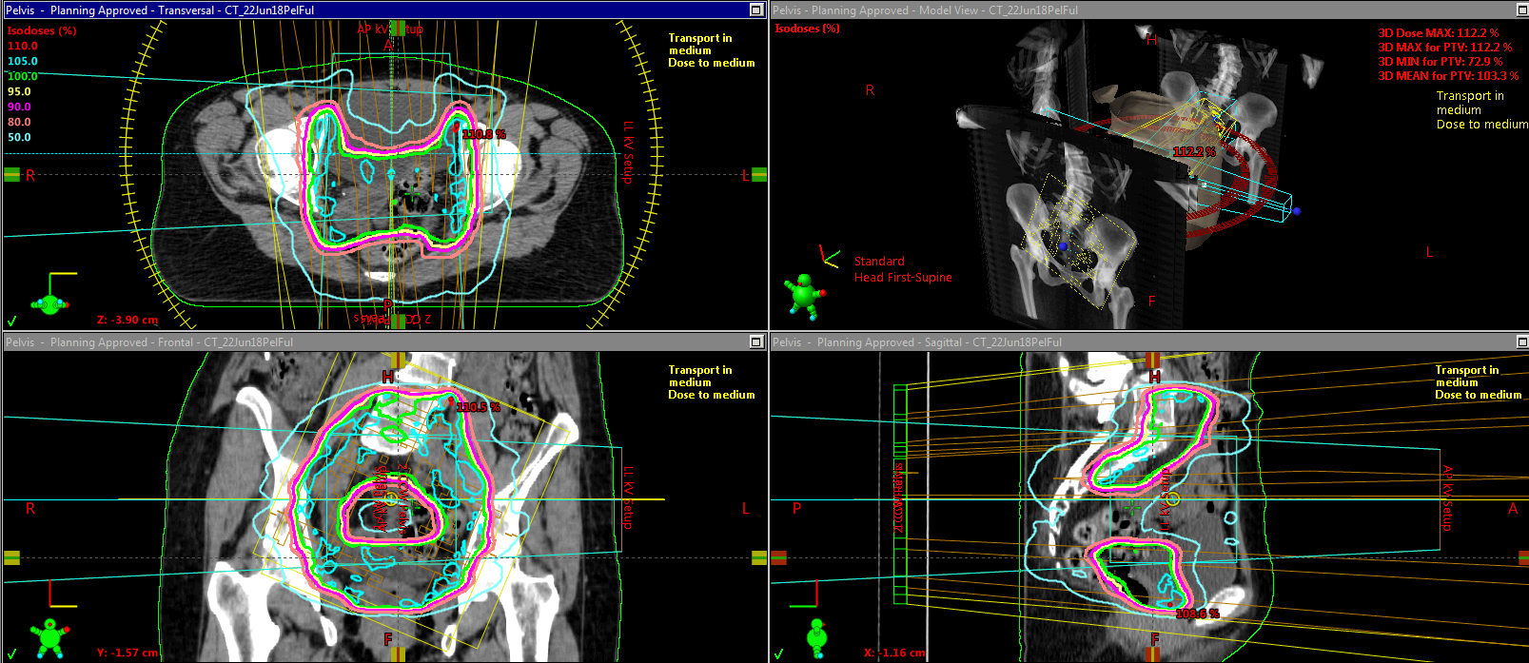
Endometrial Cancer

Slide 27

Endometrial Cancer
Medically Inoperable
Radiation can offer long term cure
Brachytherapy alone for small/superficial tumors
EBRT + Brachy for larger/deeper tumors

Slide 28
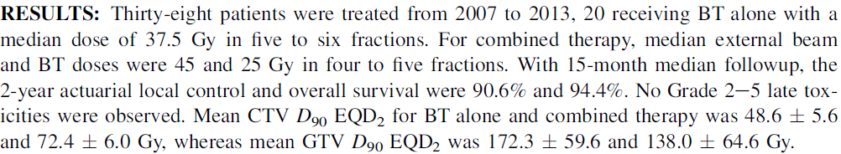
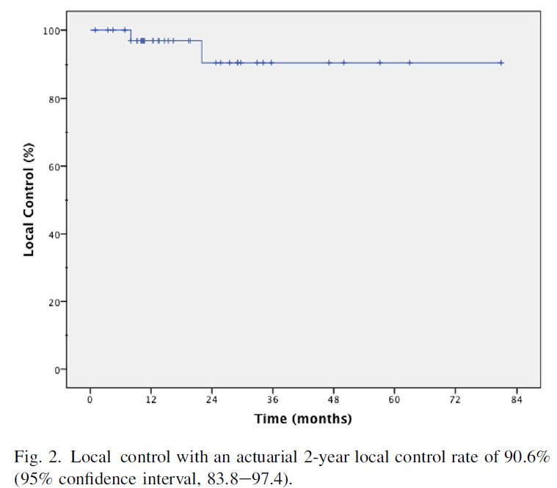
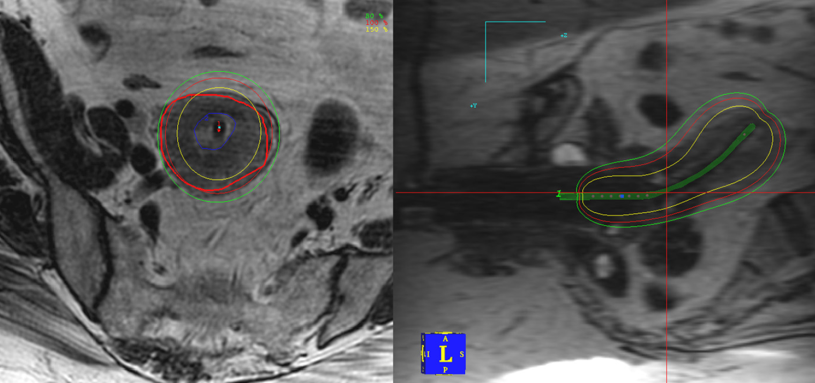
Endometrial Cancer

Slide 29
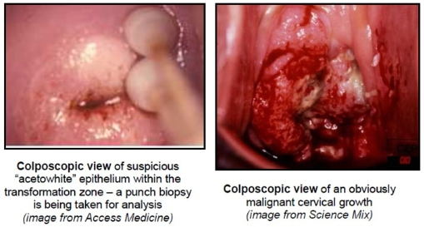
Cervical Cancer
Present with abnormal pap smear or vaginal bleeding
Very strong association with HPV
Vaccine against HPV available
Pelvic exam demonstrates cervical dysplasia or mass
Notes:
Age 11-26

Slide 30
Cervical Cancer
Biopsy performed
Cervical cancer is staged clinically
goal is to have staging applied similarly in developing world
still, PET/CT and MRI of the pelvis are routinely part of work-up and help guide treatment decisions in the developed world
Staging

Slide 31
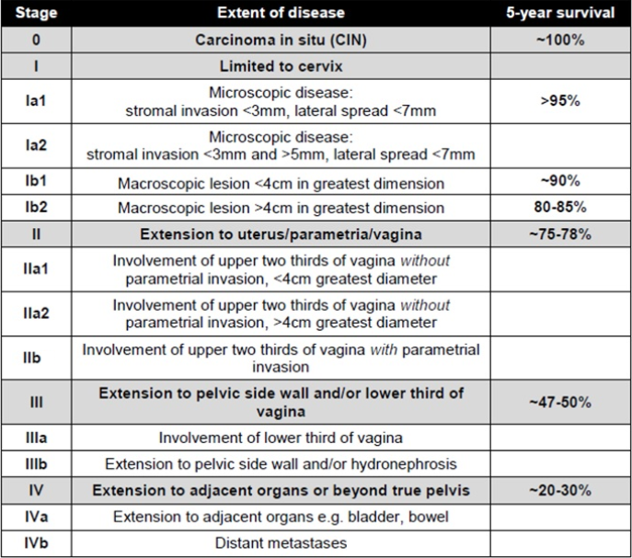
Cervical Cancer

Slide 32
Cervical Cancer
Early Stage (IA, IB1, IIA1)
Surgery typically indicated
Extent of surgery dependent upon stage and size
Small tumors may be amenable to fertility sparing procedure
Larger tumors require hysterectomy with extent dependent upon size/stage
Adjuvant therapy dependent upon surgical findings
Locally Advanced (1B2, IIA2, IIB or higher, LN+)
Non-operative management preferred
External Beam Radiation with Concurrent Chemotherapy followed by Brachytherapy (Internal Radiation)

Slide 33
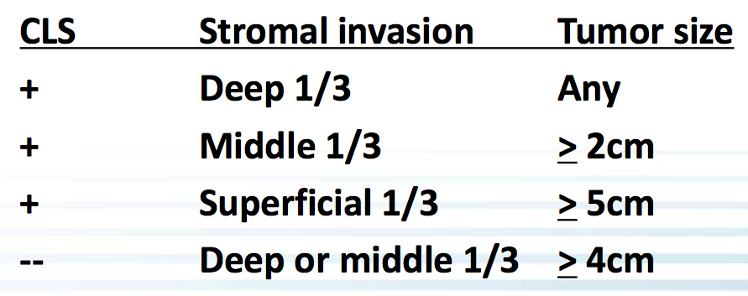
Cervical Cancer – Early Stage
GOG 92 (Sedlis)
Early stage, intermediate risk:
LVSI
Deep 1/3 stromal invasion
>4cm tumor
Stage IB tx’d with rad hyst, LN-, margin-
≥2 factors
Obs vs WP 46-50.4 Gy
RT improved LC (79→86%); OS NS
Consider for adeno or with 1 RF, had large reduction in recurrence (8% vs. 44%)

Slide 34
Cervical Cancer – Early Stage
GOG 109 (Peters)
Early stage, high risk:
+ Margin
+ LN
+ Parametria
IA2-IIA w/ LN+, +margin or +parametria after RH/PLND
WP 49.3/29 (1.7/fx, 45 PA if common iliac +) +/- cis/5FU q3wk x4c (2 concurrent, 2 adjuvant)
CRT improved OS (71→81%) vs. RT
CRT improved LC (79→91%) vs. RT

Slide 35

Cervical Cancer – Early Stage
How is adjuvant RT given?
Pelvic EBRT very similar to endometrial cancer
Brachytherapy not routinely performed

Slide 36
Cervical Cancer – Higher Stage
Landoni Trial
N=469 with IB or IIA cervical CA
RCT → EBRT+LDR vs. Surgery
Surgery: class III radhys +/- adj XRT if high-risk (pT2b+, <3mm “safe” cervical stroma, cut-through, or +LN)
RT: 40-53 Gy in 1.8-2 Gy/fx to pelvis and intracavitary brachy (pt A 70-90 Gy)
Outcomes same: 5y OS 83%, DFS 74%, recurrence ~25%
Gr 2-3 toxicity worse with S: 28% (vs. 12% RT)
54% of IB1 and 84% of IB2 needed RT (in S arm)
Maybe IB2 should just get CRT

Slide 37
Cervical Cancer
How is radiation performed for locally advanced cervical cancer?
45 Gy of EBRT in 25 fractions
Involved lymph nodes treated to 55 – 57.5 Gy in 25 fractions
EBRT is combined with concurrent chemo
Most commonly weekly Cisplatin
Toward the end of EBRT brachytherapy is initiated
Goal of finishing all treatment in less than 8 weeks
Improves control rates

Slide 38
Cervical Cancer
What are the types of brachytherapy used for cervical cancer?
Intracavitary vs interstitial
Depends on extent of disease
Intracavitary applicators include
Tandem and ovoids
Ring and tandem
Indications for interstitial
Extensive lateral spread of tumor (>2-3 cm from midline at time of brachytherapy)
Distal vaginal involvement
Anatomic inability to place intracavitary applicator

Slide 39
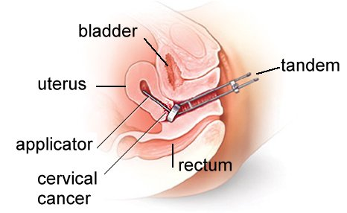
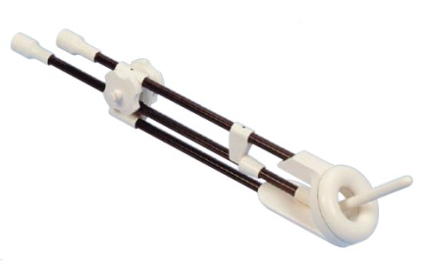
Cervical Cancer

Slide 40
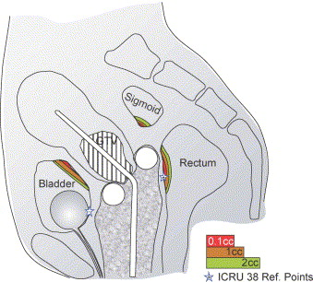
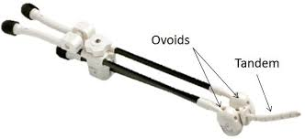
Cervical Cancer
Radiotherapy and Oncology, Volume 78, Issue 1, January 2006, Pages 67-77

Slide 41
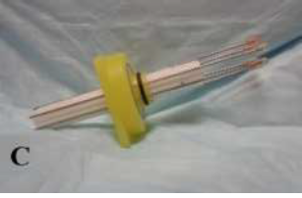
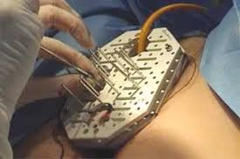
Cervical Cancer

Slide 42
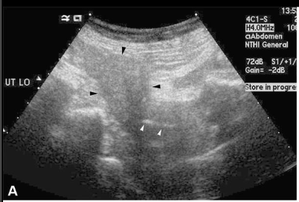
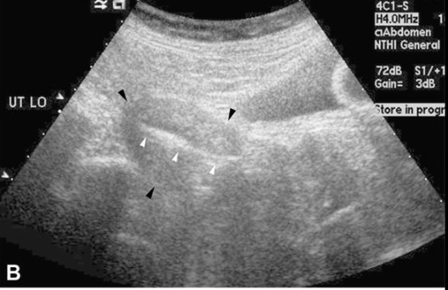
Cervical Cancer
How is intracavitary brachytherapy preformed?
Conscious sedation or general anesthesia for insertion
Paracervical block (local anesthesia)
Ultrasound guidance for tandem placement
Time from applicator insertion to treatment delivery is about 3-4 hours

Slide 43
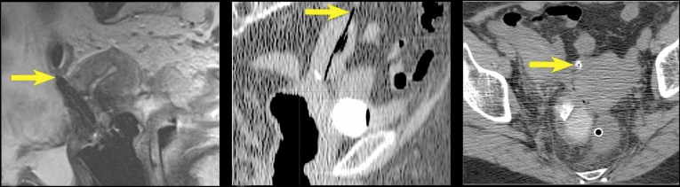
Cervical Cancer

Slide 44
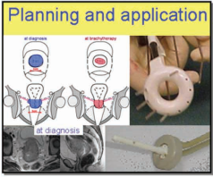
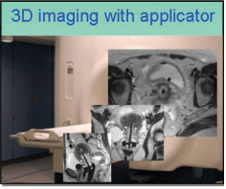
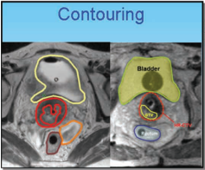
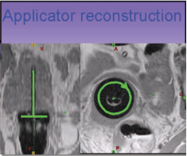
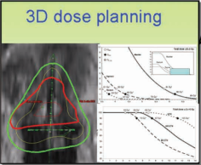
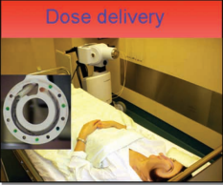
Cervical Cancer

Slide 45
Cervical Cancer
How is interstitial brachytherapy preformed?
OR with general anesthesia and epidural
Patient admitted to hospital for 2-3 nights
Needles stay in place for 2.5 days
Five fractions of radiation
One on day of procedure, two per day the next two days
Applicator comes out in radiation department after 5th fraction
Epidural is discontinued
Patient discharged

Slide 46
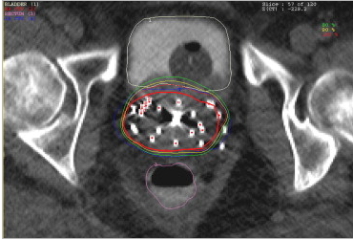
Cervical Cancer

Slide 47
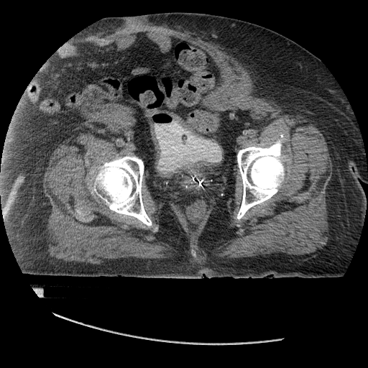
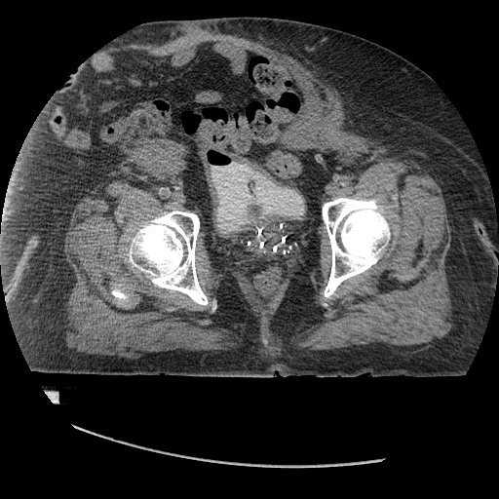
Cervical Cancer
Needle placement is iterative process done with CT guided adjustment
Pre adjustment
Post adjustment

Slide 48
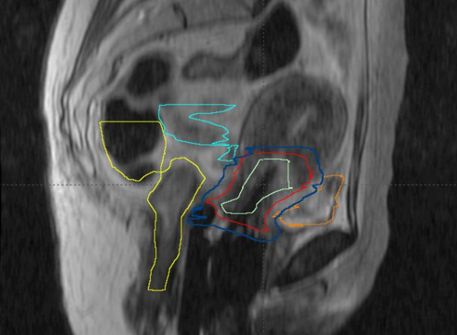
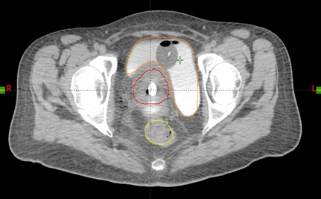
Cervical Cancer
Contouring Target and organs at risk (OAR)

Slide 49
Cervical Cancer
 | Date | 11/21/17 | 11/30/17 | 12/03/17 | 12/07/17 | 12/10/17
External Beam Dose |  | 45 | 45 | 45 | 45 | 45 | 45
Prescribed Dose |  | 5.5 | 5.5 | 5.5 | 5.5 | 5.5 | 27.5
Pt.A |  | 6.25 | 6.76 | 6.42 | 6.42 | 6.35 | 77.19
Bladder 0.1cc Dose |  | 12.54 | 9.92 | 8.93 | 9.35 | 9.07 | 94.81
Bladder 1cc Dose |  | 9.63 | 8.00 | 6.99 | 7.49 | 7.49 | 84.59
Bladder 2cc Dose | Dose | 8.80 | 7.24 | 6.42 | 6.75 | 6.75 | 80.95
Bladder 5cc Dose |  | 7.24 | 6.05 | 5.17 | 5.60 | 5.60 | 74.65
Rectum 0.1cc Dose |  | 2.29 | 3.08 | 4.35 | 4.16 | 2.91 | 61.78
Rectum 1cc Dose |  | 1.86 | 2.44 | 3.08 | 2.59 | 2.14 | 57.11
Rectum 2cc Dose |  | 1.73 | 2.14 | 2.75 | 2.29 | 1.86 | 55.77
Rectum 5cc Dose |  | 1.23 | 1.73 | 2.00 | 2.00 | 1.47 | 53.43
Sigmoid 0.1cc Dose |  | 8.53 | 9.63 | 9.80 | 11.87 | 6.51 | 91.34
Sigmoid 1cc Dose |  | 6.51 | 7.24 | 7.24 | 8.26 | 5.17 | 79.41
Sigmoid 2cc Dose |  | 5.60 | 6.28 | 6.51 | 7.49 | 4.35 | 75.22
Sigmoid 5cc Dose |  | 4.35 | 4.96 | 5.17 | 6.28 | 3.42 | 69.17
HR CTV D90 |  | 9.72 | 8.00 | 8.37 | 8.94 | 8.65 | 88.68
IR CTV D90 |  | 6.59 | 6.08 | 6.59 | 7.10 | 7.02 | 78.38
GTV D90 |  | 11.36 | 11.36 | 11.36 | 11.36 | 11.36 | 101.79

Slide 50
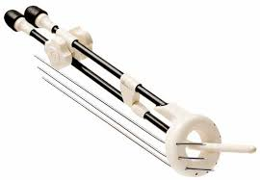
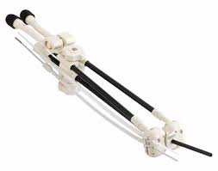
Cervical Cancer
Hybrid Intracavitary Interstitial Applicators
Bulky disease, especially residual medial parametria and asymmetric disease

Slide 51
Vaginal Cancer
Primary cancer of the vagina is rare (2% of gyn cancer)
Majority are squamous cell
Cannot involve vulva or cervix
By definition if a cancer involves both the vagina and either the vulva or the cervix, it is treated as a cervical cancer or a vulvar cancer, not a vaginal cancer
More common than primary vaginal cancer is vaginal recurrence of other gynecological cancers
Most commonly endometrial cancer
Salvage rate 50%

Slide 52
Vaginal Cancer
Treatment
Surgery can be considered for small superficial lesions
Most frequently treated with definitive radiation +/- chemo

Slide 53
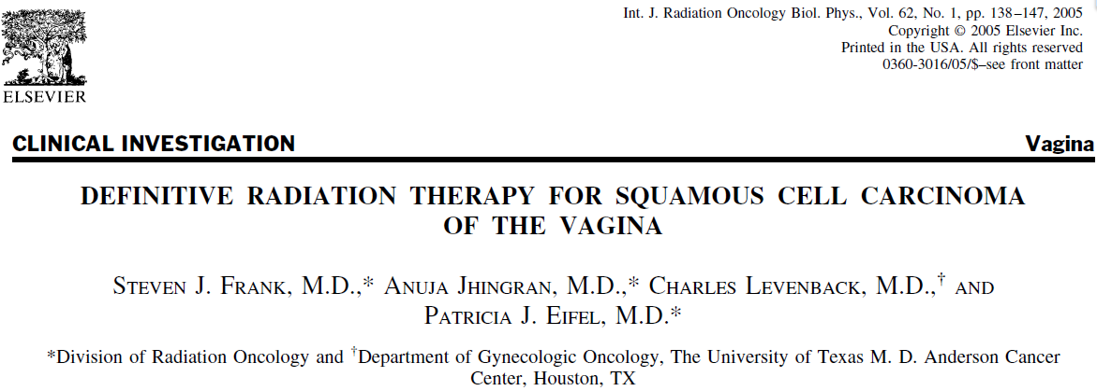
Vaginal Cancer
193 patients from 1970-2000

Slide 54
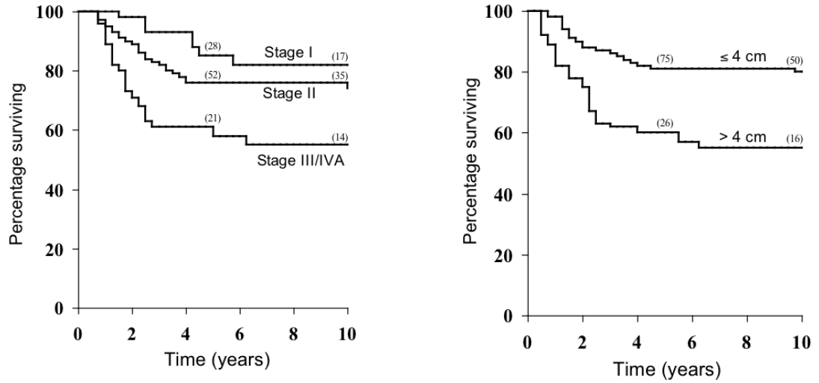
Vaginal Cancer

Slide 55
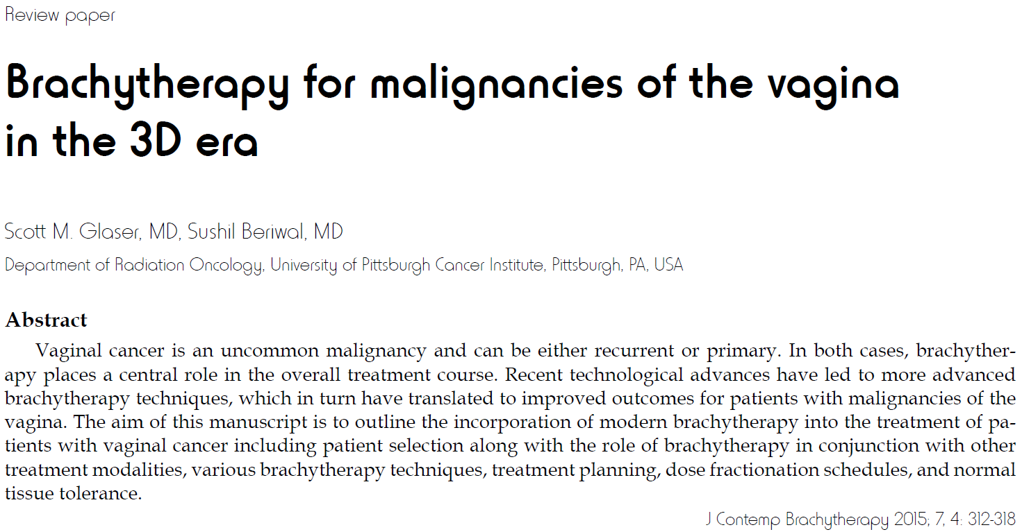
Vaginal Cancer

Slide 56
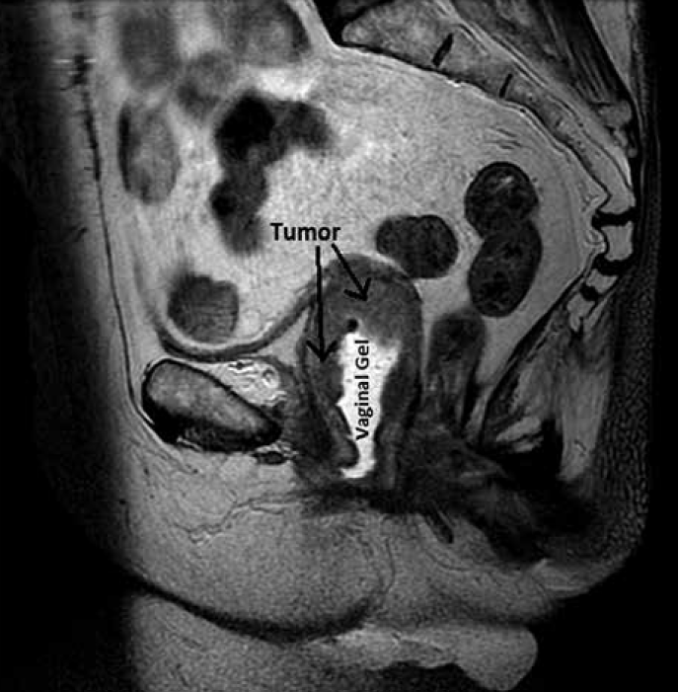
Vaginal Cancer

Slide 57
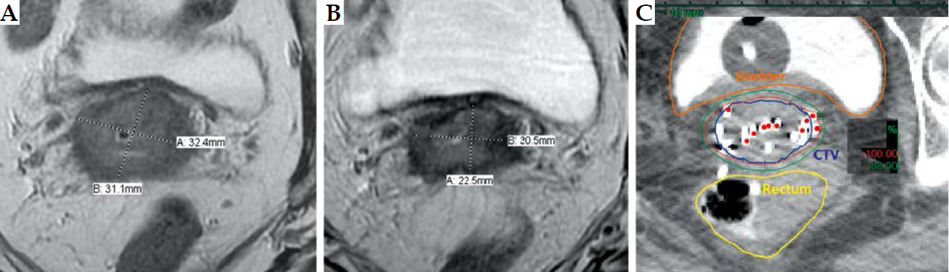
Vaginal Cancer

Slide 58
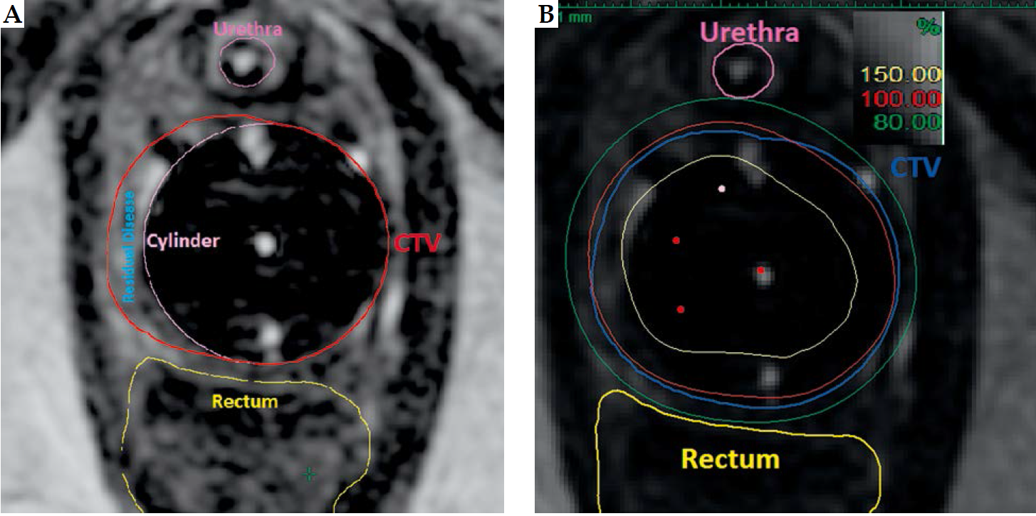
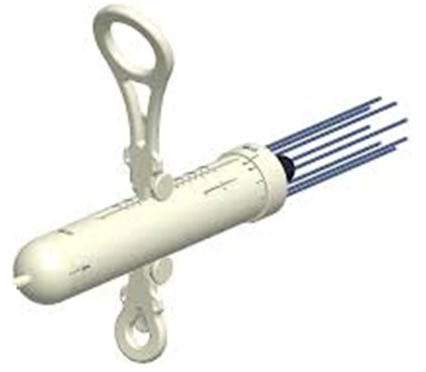
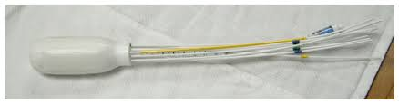
Vaginal Cancer

Slide 59
Vulvar Cancer
Presents as vulvar mass/lesion
Primary risk factors include HPV and Lichen Sclerosis
Management
Upfront surgical management for small tumors (< 4cm) not involving critical structures
Partial vulvectomy and lymph node evaluation (SLNBx typically)
Adjuvant RT based on pathological risk factors
Neoadjuvant Chemo-RT for borderline resectable tumors
Definitive Chemo-RT for unresectable tumors.

Slide 60
Vulvar Cancer
FIGO Staging
IA: <2cm AND <1.0mm stromal invasion
IB: larger, but still in vulva/perineum
II: Distal 1/3 urethra, vaginal, or anal involvement
III: LN positive, NO relation to T stage
N1 – IIIA, N2 – IIIB, but ECE = IIIC
IVA: Fixed/ulcerated LN, or more extensive locally

Slide 61
Vulvar Cancer - Postop
Heaps (1990)
SM >=8mm = 0% RR
SM < 8mm = 48% RR
Other predictors for recurrence:
DOI >9mm
Tumor thickness > 1cm
Infiltrative (rather than pushing border)
LVI+
Increased keratin
>10mm
Indications for adjuvant RT to primary
Close margins <8mm
Tumor Size
DOI > 5 - 9mm
+ LVSI
For Lymph nodes:
If LNs not evaluated
SLN+
After LND+, if >1 LN+, >2 – 5mm metastasis, or ECE
>=20% ratio of ipsilateral LN+
Consider chemotherapy

Slide 62
Vulvar Cancer - Postop
Faul, 1997, retrospective
62 pts w/ <8mm margin, 31 tx w/ RT to vulva
LR in 58% of observed, 16% of RT group
Viswanathan, 2013, retrospective
205 pts, margin status re-quantified
Negative >1=cm (34%), close <1cm (56%), positive (10%)
All treated with RT to Vulva +/- inguinal nodes, 2D
Highest risk with margins <=5mm
Radiation dose >=56Gy had lower relapse risk than <=50.4Gy

Slide 63
Vulvar Cancer – Post op
GOG 37 – Adjuvant RT for LN+
Ipsilateral Pelvic LN dissection vs B/L inguinal/pelvic RT 45-50Gy
No RT to vulva
Radiation Improved:
2-yrs OS 54 vs 68%, Groin failures 24 vs 5% (SS)
Vulvar recurrence similar (9%)
Subset analyses
Worse survival with surgery if cN+ or >=2LNs
No difference between RT and PLND if single LN+

Slide 64
Vulvar Cancer - Advanced
GOG 205
Phase II – Unresectable T3/T4, any N, 58 pts
57.6Gy @ 1.8Gy/fx qD w/ weekly cisplatin, followed by resection
N0 - RT to primary (groin at discretion of MD)
N+ - Vulva, inguinofemoral, lower pelvic LNs
cCR in 37/58 (64%)
29 had PCR (78% of cCR, 50% of total)
GOG 279
Ongoing, increase RT dose to 64 Gy and add Gemcitabine

Slide 65
Vulvar Cancer
GRONISS-V II
Prospective study currently in progress
< 4cm confined to Vulva
Initial Protocol
If SLNB-, no further therapy
If SLNB+, randomized to:
Adjuvant RT (w/ chemo at discretion)
Completion of superficial and deep inguinofemoral LND
Interim safety monitoring showed high rate of in-field groin failures (20% in macromets, 2% in micromets)
Protocol changed to mandate dissection followed by adjuvant RT in all LN dz > 2mm size
Micromets still randomized

Slide 66
Ovarian Cancer
Radiation is not typically used in ovarian cancer
Treatment consists primarily of surgery and chemotherapy
In rare case, radiation is considered
Pelvic/periaortic LN recurrence/persistence despite systemic therapy in the absence of other metastatic disease
Data

Slide 67
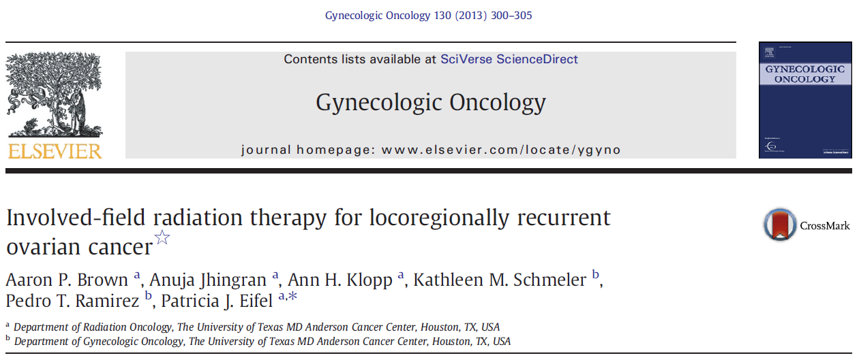
Ovarian Cancer
102 patients with epithelial ovarian cancer treated with RT to a dose of 45 Gy or more
50% nodal recurrence, 50% extranodal

Slide 68

Ovarian Cancer

Slide 69

Ovarian Cancer

Slide 70
Conclusions
In early stage endometrioid adenocarcinoma, the most common site of recurrence is the vaginal cuff forming the rationale for vaginal cuff brachytherapy
For locally advanced cervical cancer, the preferred treatment is non-operative, including EBRT with concurrent chemotherapy followed by brachytherapy
Adjuvant radiation therapy for node positive vulvar cancer improves both locoregional control and overall survival
Radiation therapy is not commonly used in ovarian cancer

Slide 71
Thank You

